Slide 1

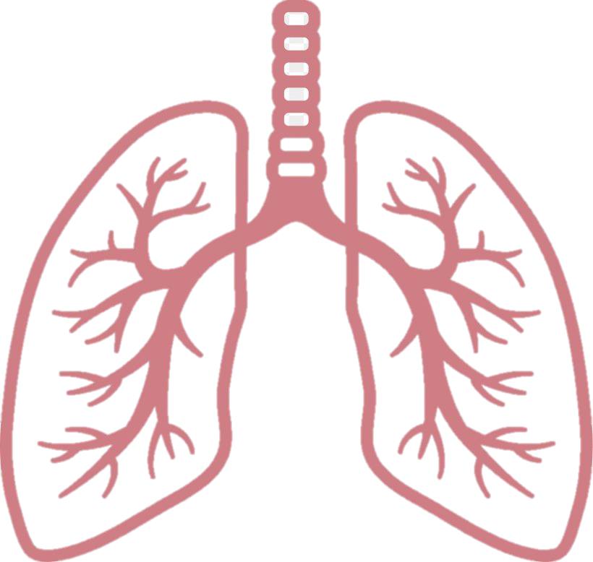
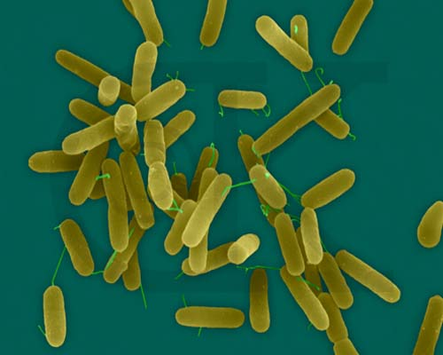
From single species systems to complex microbial communities
Metagenomic approaches to study the sociobiology of the microbiome

Slide 2
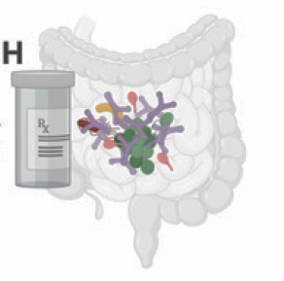
2
Using evolutionary theory to predict the effect of microbes on host health
Probiotics to restore microbiome health
Specific taxa
Less diversity
Gene expression
More diversity
🤔
Specific pathways
→ Evolutionary approach for more unifying principles
Can (socio)evolutionary theory help us predict microbiome functions and the signature of dysbiosis?

Slide 3
A general prediction of social evolution theory
Importance of population genetic structure
High relatedness
Low relatedness
Vs.
Interactions occur between genetically similar individuals
Cooperation evolves
All else being equal,
increased relatedness should favour the evolution of cooperation

Slide 4
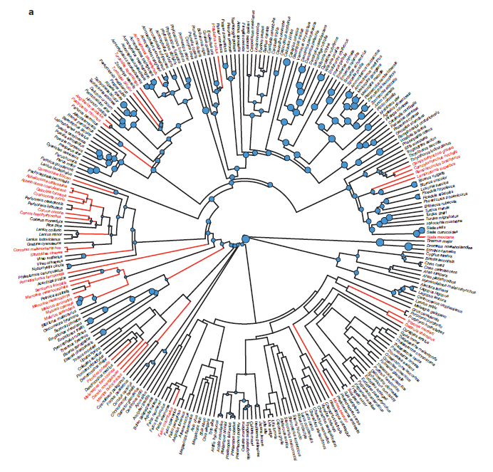

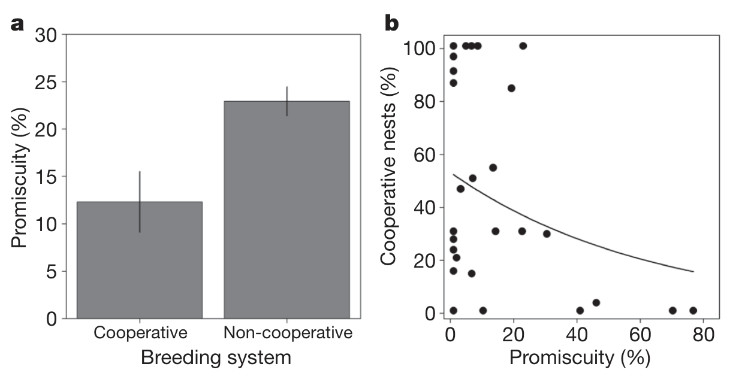
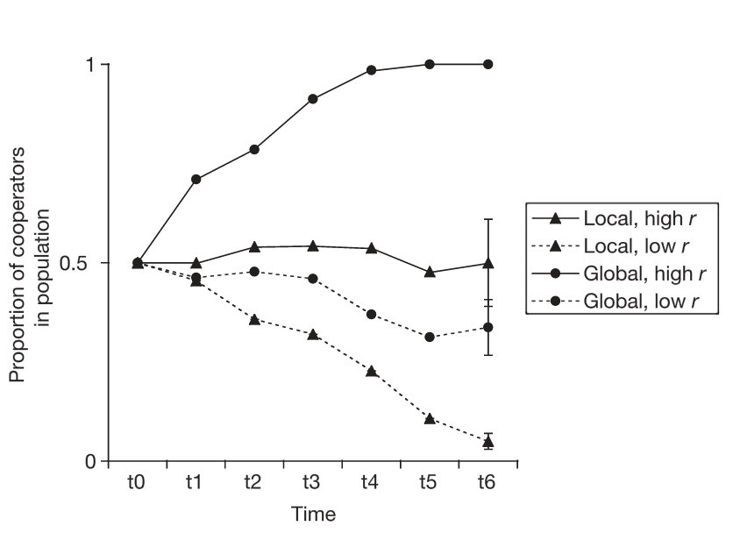
Testing the predictive power of relatedness
Comparative analyses
Manipulate relatedness in the lab
Cornwallis et al. 2010
Griffin et al. 2004
What is the general predictive power of relatedness in microbes, living in natural complex MC?
Comparative analysis in Human gut microbiome

Slide 5



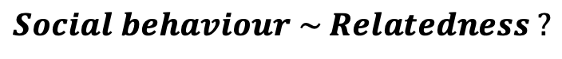
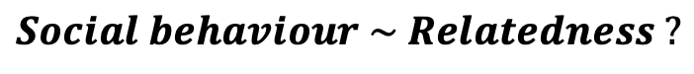

Metagenomic approach to assess the predictive power of relatedness in complex microbial communities
Cooperative behaviour
Relatedness
Real world data:
Human gut metagenomes
Phylogenetic mixed model
$$Social behaviour \sim Relatedness ?$$

Slide 6
Step 1: measure relatedness

Slide 7
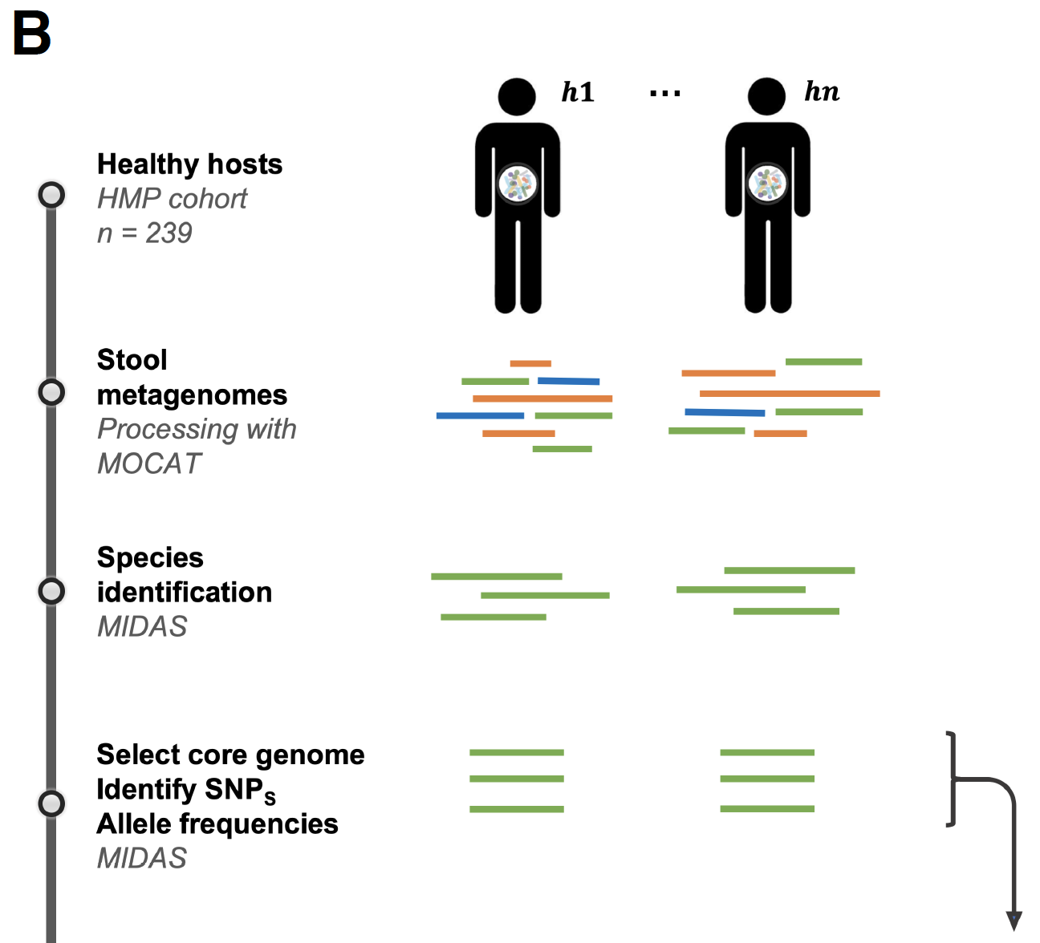
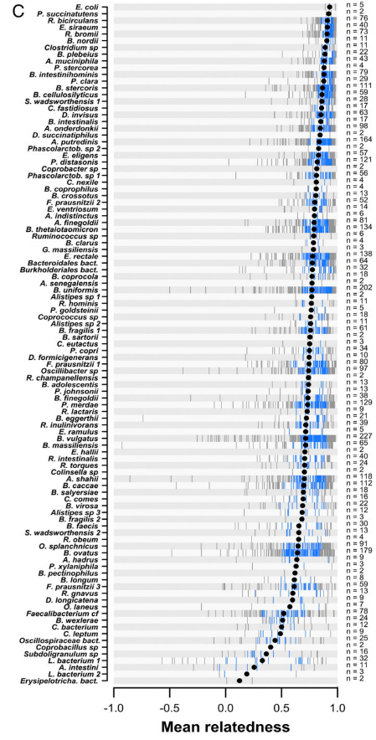
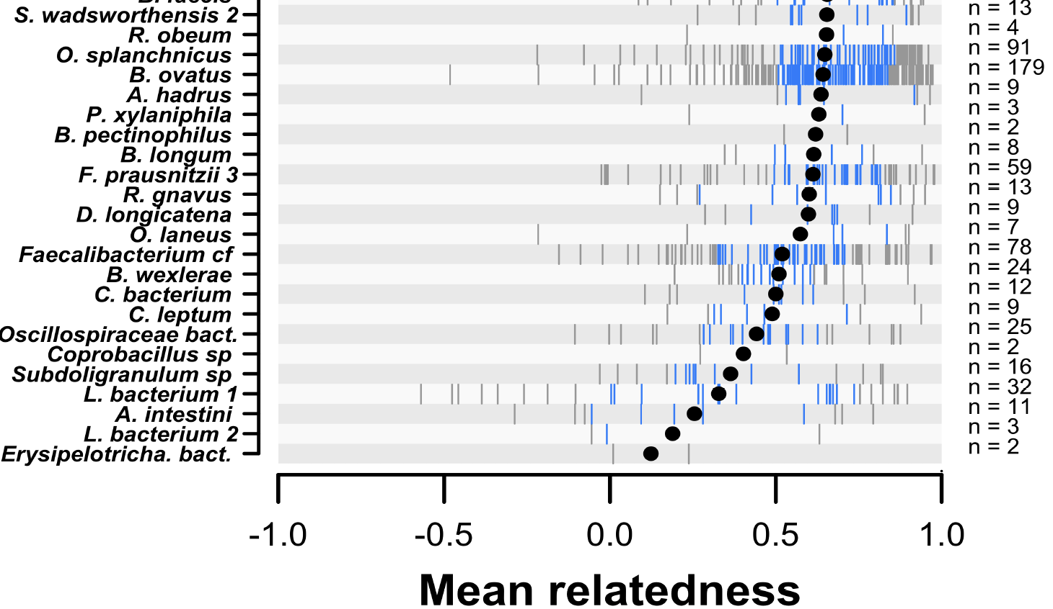
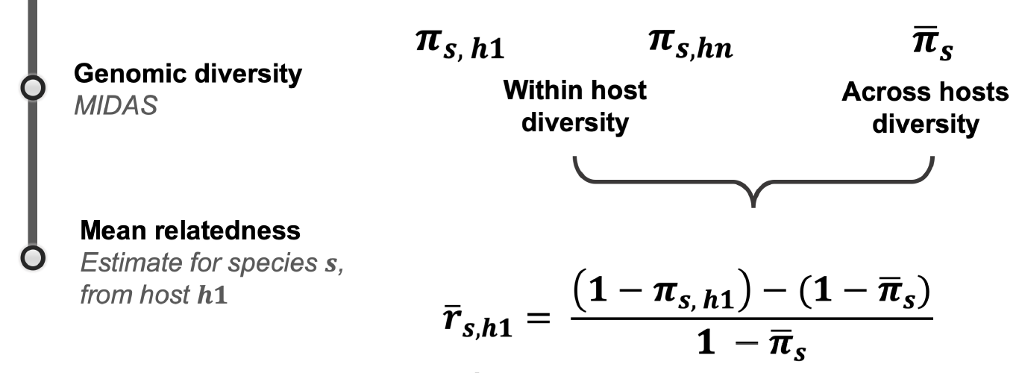
(MIDAS – Nayfach et al, 2016)

Slide 8
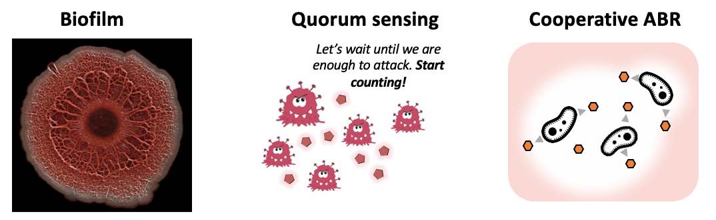

Step 2: measure sociality
Computational approaches to measure sociality from genome content
Computational prediction of proteins localisation
Public goods
=
SECRETED PRODUCTS
Notes:
We assessed a microbe’s propensity for cooperation from their genome content

Slide 9
Step 2: measure sociality
Computational approaches to measure sociality from genome content
Computational prediction of proteins localisation
Public goods
=
SECRETED PRODUCTS
1
2
Measure of cooperativity:
Number of genes coding for secreted products
Notes:
We assessed a microbe’s propensity for cooperation from their genome content

Slide 10
Step 2: measure sociality (cont’d)
Notes:
We assessed a microbe’s propensity for cooperation from their genome content

Slide 11

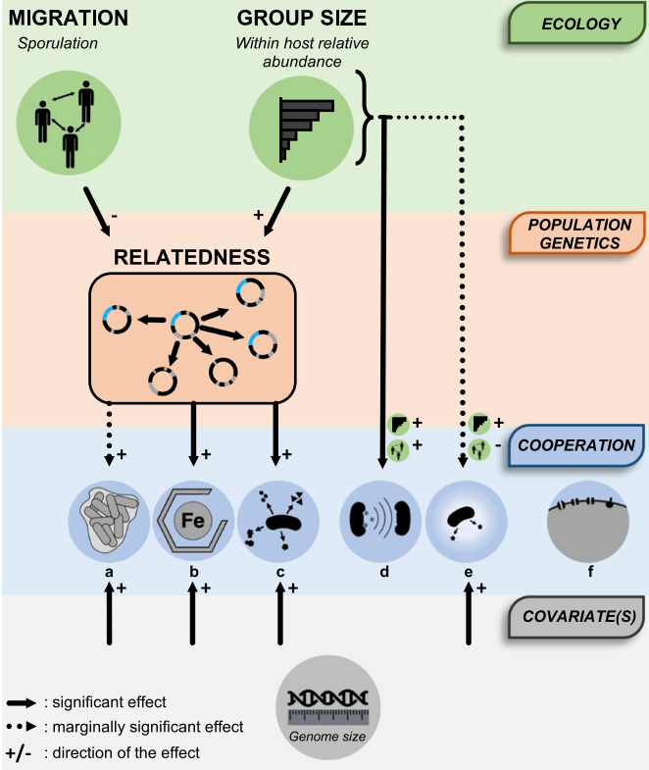
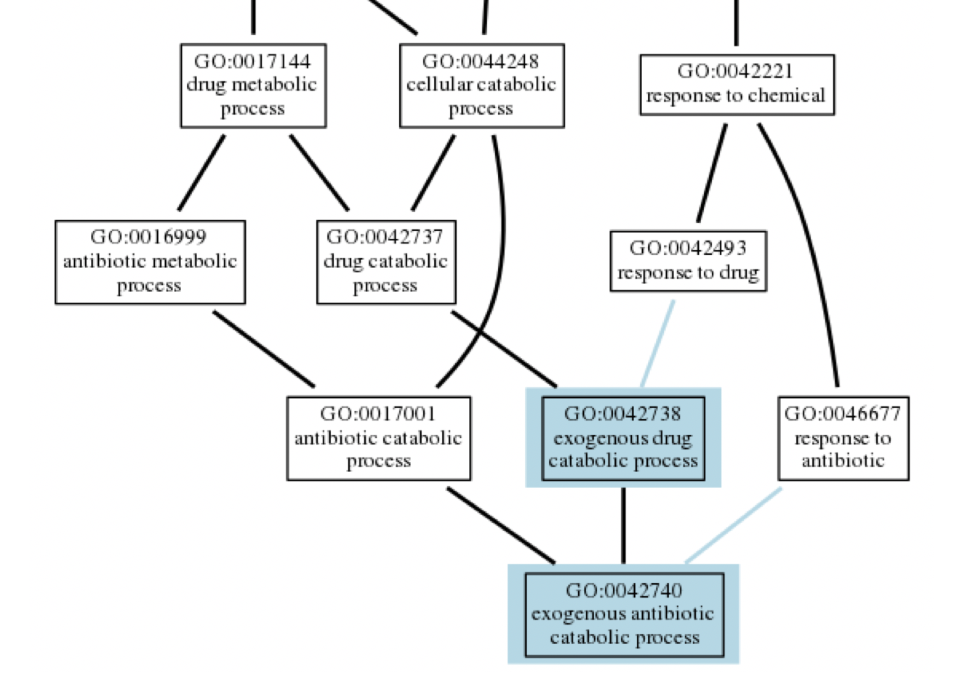

Step 2: measure sociality (cont’d)
Biofilm GOs
Annotate all genes
Biofilms
GO:00238
GO:00399
GO:00467
gene 1 = GO:00467
gene 2 = GO:09182
gene 3 = GO:00238
…
gene n = GO:00222
Siderophores
Well known social behaviours in bacteria
Quorum-sensing
Biofilm formation
GO:00238
Antibiotic degrading enzymes
Measure of cooperativity: number of genes annotated with a “social GO”
Secretion systems
Extracellular matrix production
GO:00399
Cell-cell adhesion
GO:00467
→ Measure for 5 different forms of cooperation

Slide 12
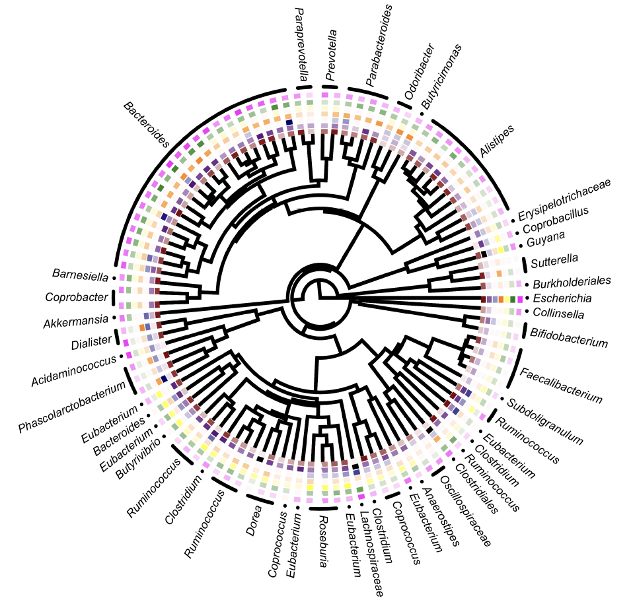
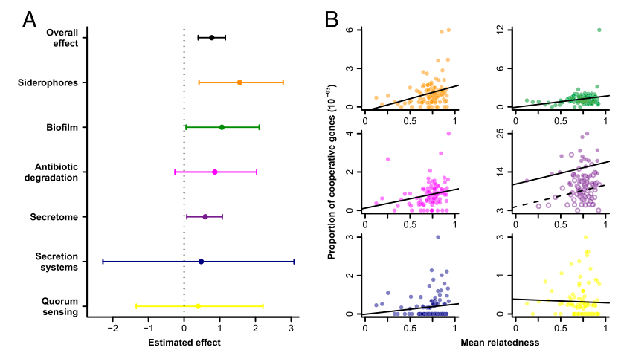
Comparative analysis
Simonet& McNally, 2021, PNAS

Slide 13
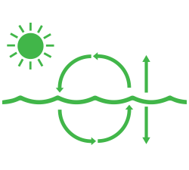



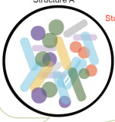
Seeking unifying principles for MC engineering
Which mechanisms are of general importance?
Group size
Transmission ecology
Relatedness
Host immune system
?
Notes:
We are still a long way from MC engineering science
Microbes live in complex communities

Slide 14
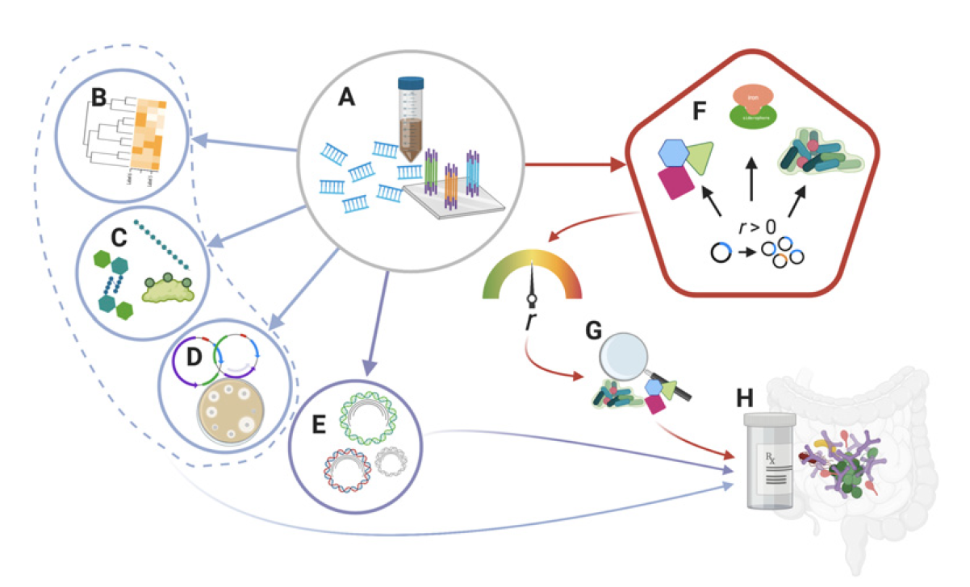
Sociomicrobiology for microbiome engineering
Andersen & Schluter, 2021, PNAS

Slide 15
Acknowledgement
Luke McNally (https://lukemcnally.wordpress.com/)
Rosalind Allen (https://www2.ph.ed.ac.uk/~rallen2/)
Jarrod Hadfield
Dan Nussey
Kevin Foster

Slide 17
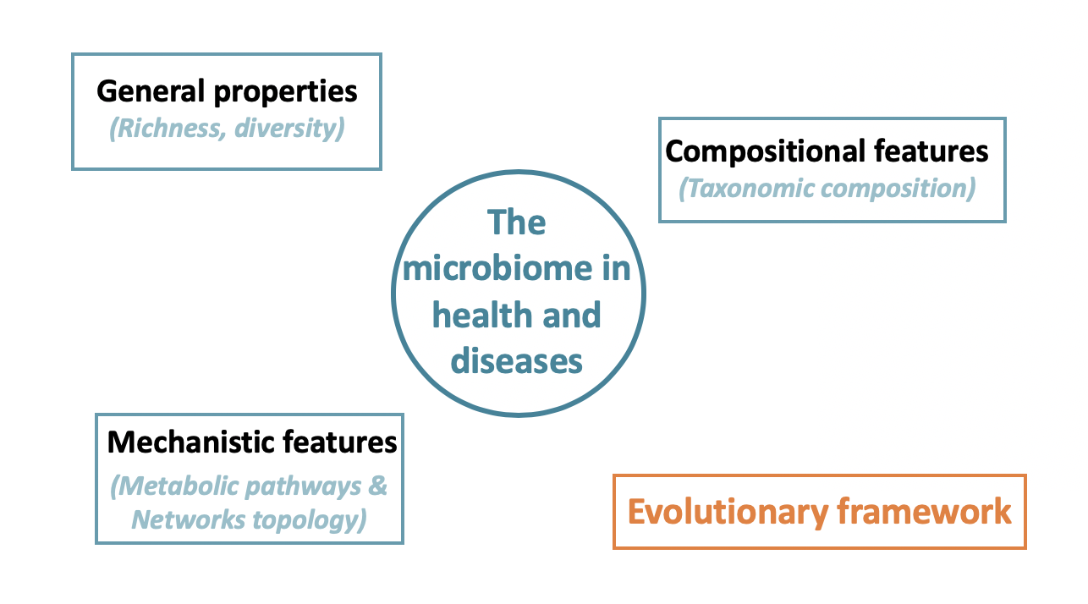
2
Using evolutionary theory to predict the effect of microbes on host health
“eco-socio-evo” definition of dysbiosis
What does (socio)evolutionary theory tell us about the microbiome-health relationship?

Slide 18


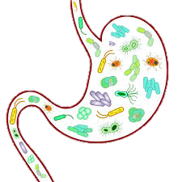
A gut microbe life: strive competition and transmit
Microbe-host
Host-microbe
Microbe-microbe
Population genetics
(Relatedness)
Transmission ecology
(Ability to form spores)
Notes:
The effect on the host is ultimately nothing else than a collection of behaviours that the microbe engage in to live its life
Taking an evolutionary standpoint, this means that we can express the fitness of an individual microbe as a function of these different ecological and population genetics parameter, and ask, how will those parameter shape the effect that an individual microbe should have on its host?

Slide 19
A gut microbe life: strive competition and transmit
Microbe-host
Host-microbe
Microbe-microbe
Population genetics
(Relatedness)
Transmission ecology
(Ability to form spores)
Notes:
The effect on the host is ultimately nothing else than a collection of behaviours that the microbe engage in to live its life
Taking an evolutionary standpoint, this means that we can express the fitness of an individual microbe as a function of these different ecological and population genetics parameter, and ask, how will those parameter shape the effect that an individual microbe should have on its host?

Slide 20
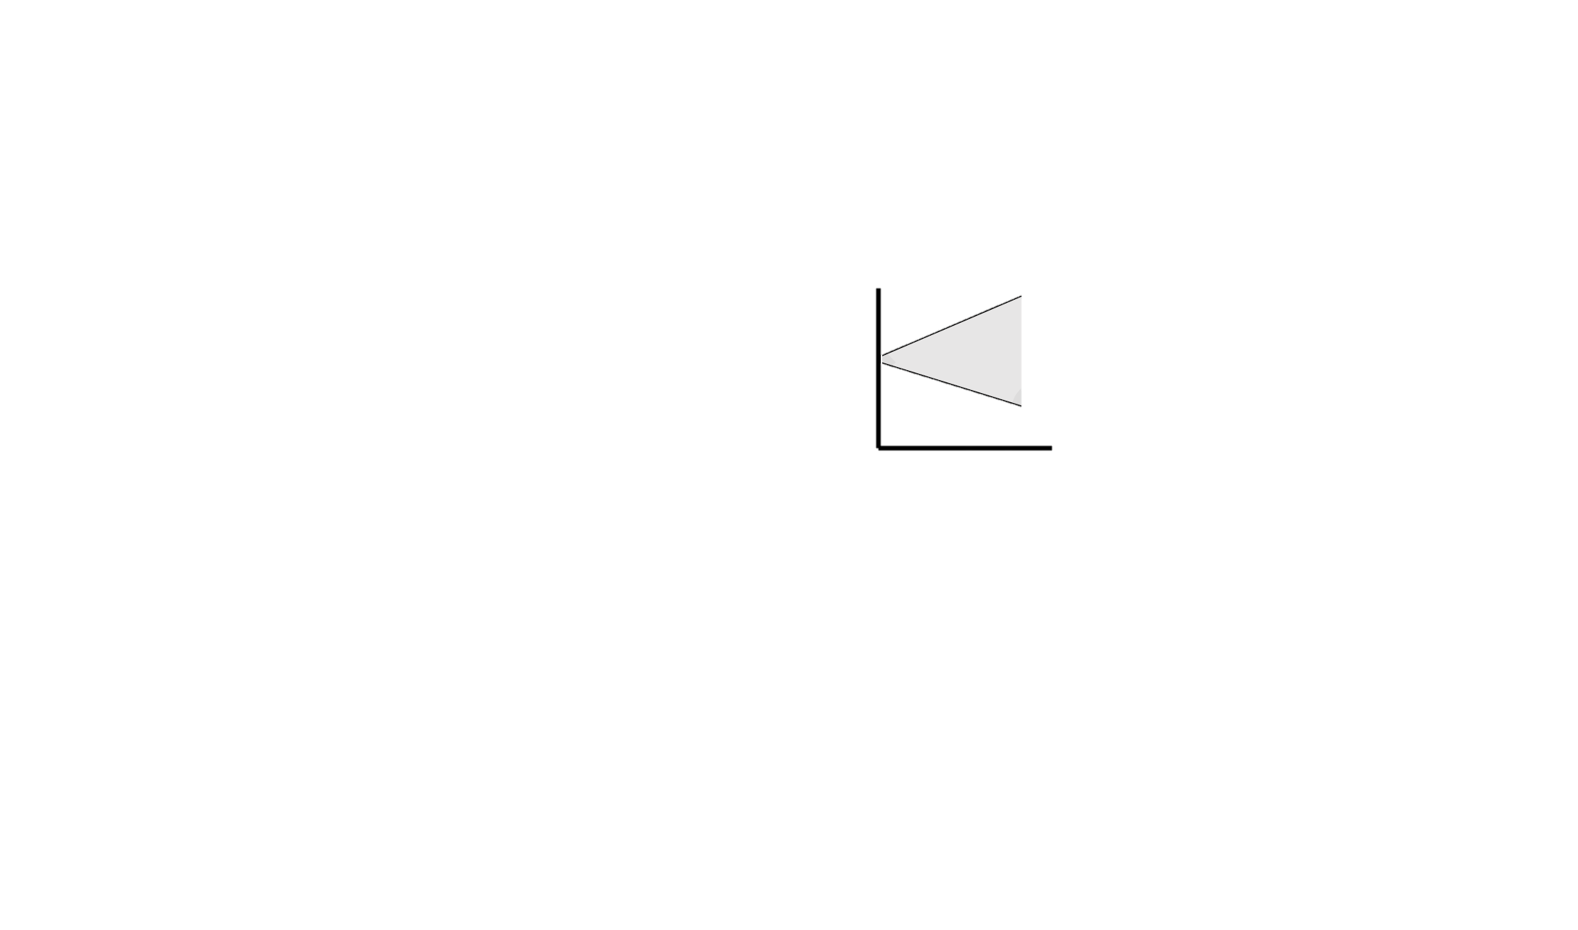

Predicted microbe effect on host health
Vertically transmit
Effect
Express fitness of an individual microbe
Derive a predicted effect on host health
Horizontally transmit
Generality
Relatedness
Relatedness → magnitude
Transmission ecology → direction
Notes:
The effect on the host is ultimately nothing else than a collection of behaviours that the microbe engage in to live its life
Taking an evolutionary standpoint, this means that we can express the fitness of an individual microbe as a function of these different ecological and population genetics parameter, and ask, how will those parameter shape the effect that an individual microbe should have on its host?

Slide 21
2
Using evolutionary theory to predict the effect of microbes on host health
Testing predictions using case-control metagenomic studies
>1700 individual faecal metagenomes
19 cohorts with case-controls
12 diseases: OBE, MetS, UC, CD, CRC, IGT, T2D, ACVD, RA, HypT, BD, LC
A Hamiltonian medicine index of microbiome health?
Effect of an Individual microbe → overall community effect
Derive ”Health index”
Predict individual health
Higher relatedness → more extreme effects
Transmission ecology → no change in direction

Slide 22
Conclusion

Slide 23
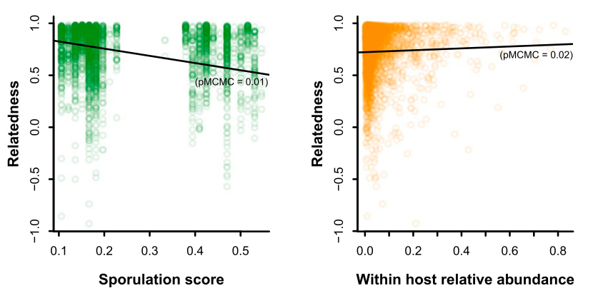
Where to next: drivers of relatedness

